Slide 1
Political preferences
Rushabh Jhaveri
NetID: rrj28

Slide 2

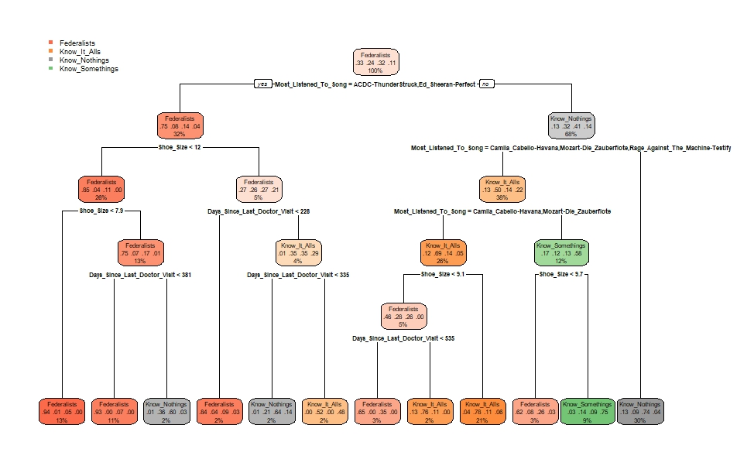
simple rpart
Using just rpart with no controls, and using all the attributes, we get the following decision tree.
On performing cross-validation and calculating the error, we get an error of 0.21675.
We can still improve upon our prediction.

Slide 3
Playing with minsplit
I then decided to toy with the value of minsplit.
Initially, I set minsplit = 50, and got the same accuracy as before.
On increasing the minsplit to 100, 200, and 300, the error increased.
On decreasing the minsplit to 25, 10, and 5, the error remained the same.

Slide 4
Playing with attributes
Since minsplit did not yield any tangible results, I decided that maybe some attributes were resulting in overfitting of the data.
I removed attributes one by one, and cross-validated the results.
In this process, I realized that only 3 attributes had significant impact – favorite song, shoe size, and time since doctor’s visit.
Out of these, the favorite song attribute was overfitting the data, and thus, I removed it from consideration.
This gave me an accuracy of 95.3 on the training data.
I was not able to submit this new CSV as I had run out of submissions, and thus my final Kaggle accuracy was only ~29.5%.

